Slide 1

Capstone Project Phase 2 GRAPH-BERT: Only Attention is Needed for Learning Graph Representations
Supervisors:
Dr. Renata Avros
Prof. Zeev Volkovich
Submitters:
Yaniv Sokolov
Shay Maryuma

Slide 2
Course Outline
Introduction
Data Set
Transformer network
Flow
GRAPH-BERT Algorithm
Project Architecture
Use Case
GUI
Verification Plan

Slide 3
Introduction
Impact Factor measures how frequently an average article in a journal is cited each year. When IF rises, so does the rate of a journal.
Coercive Citation is when an author submits a manuscript for publication in a scientific journal, the editor may request that the article's citations be expanded before it will be published.

Slide 4
Introduction
Journals these days, force writers to add irrelevant quotes from their own articles database to increase the Impact Factor of the journal.
Our project propose a solution to the problem based on the mentioned above GRAPH-BERT algorithm that will be explained.

Slide 5
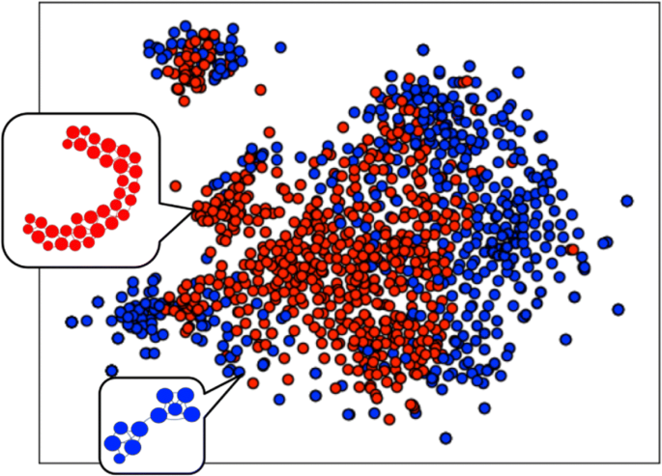
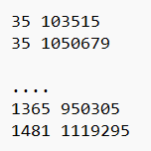
Data Set
The input in our project is a graph.
Every node in the graph is an article.
An article quote another article is a link(edge) between two nodes.
In this project we use the Cora data set.
The dataset consist of two files(“node”,”link”).

Slide 6
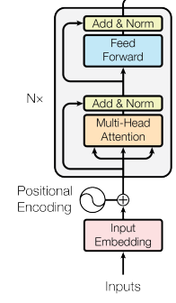
D – Layer Transformer Network
A Transformer network is intended to solve NLP problems like sentiment analysis and text summarization.
In our approach a transformer-based network is used to resolve a long-range dependencies problem.
Transformer model allow parallelization.

Slide 7
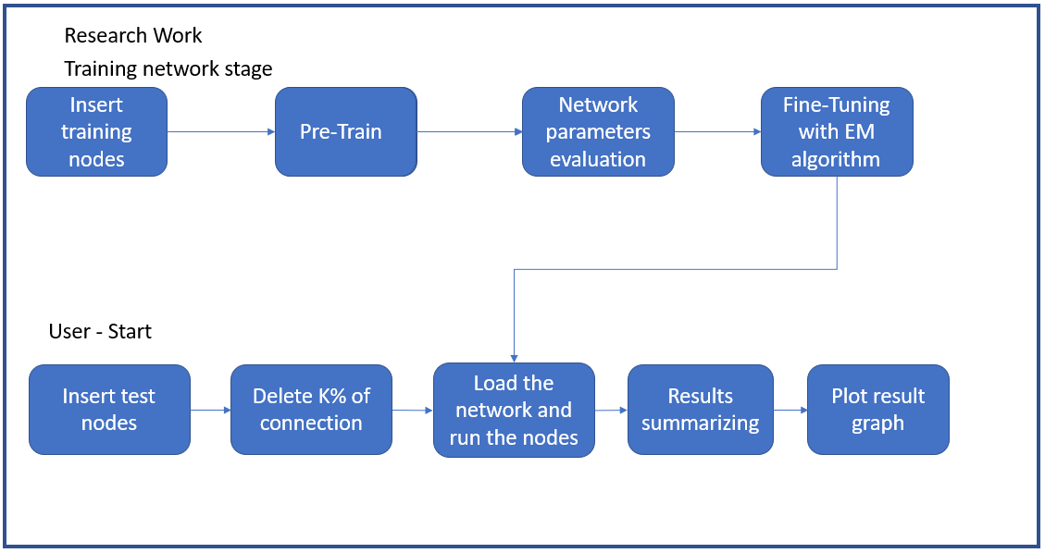
Flow

Slide 8
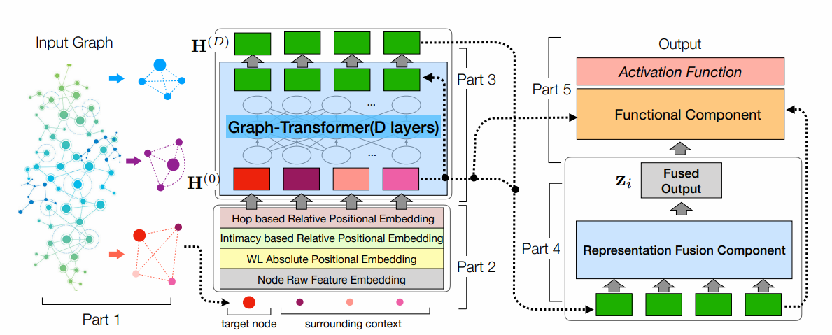
GRAPH-BERT Algorithm

Slide 9

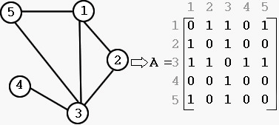



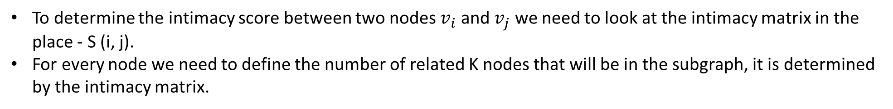
GRAPH-BERT Algorithm
Linkless subgraph
Intimacy Matrix(S)
Adjacency Matrix(A)
Corresponding diagonal matrix(D)
To determine the intimacy score between two nodes $v_{i}$ and $v_{j}$ we need to look at the intimacy matrix in the place - S (i, j).
For every node we need to define the number of related K nodes that will be in the subgraph, it is determined by the intimacy matrix.

Slide 10
Project Architecture
Randomly k% of the connections are omitted in the graph.
The GRAPH-BERT algorithm is applied aiming to recover the omitted connections.
Evaluation of the restored connections.
The steps are repeated M times, and the recovery proportion is calculated and keep for each one of edges.
Clusters that have undergone significant modifications should be examined.

Slide 11
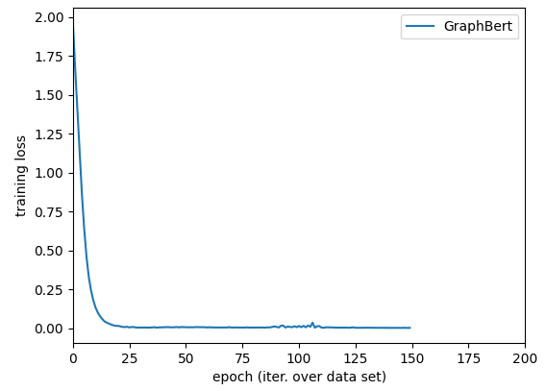
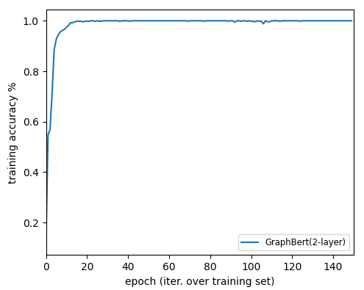
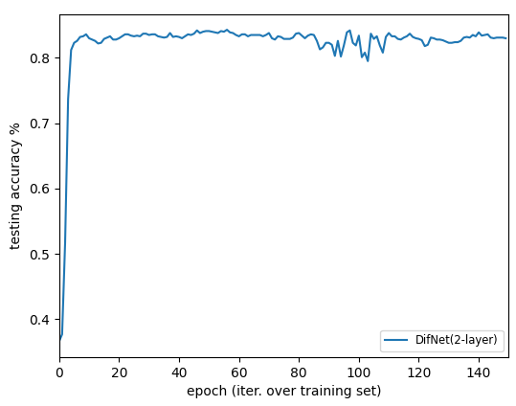
Results of the network
Result for 150 epochs:

Slide 12
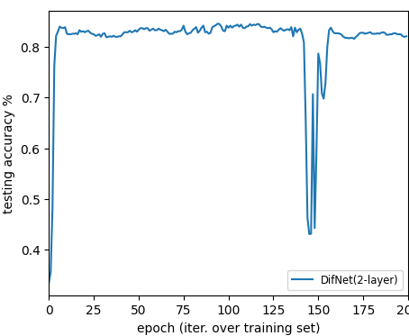
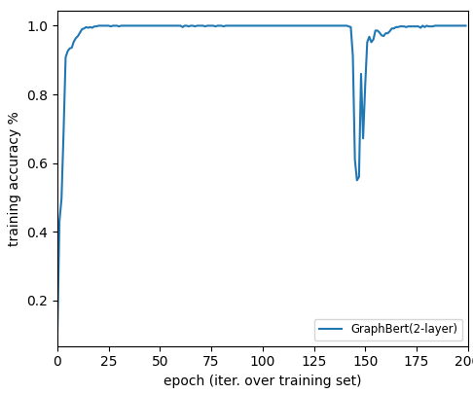
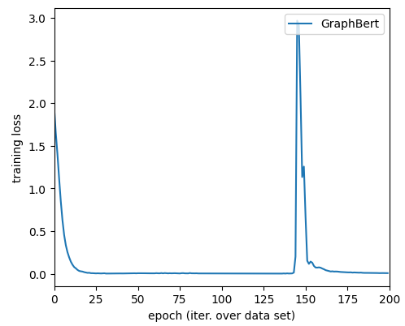
Results of the network
Result for 200 epochs:

Slide 13
Results of the network
Estimation for the 200 epochs results:
Hyperparameters: The default values of the hyperparameters in the ADAM optimizer may not be appropriate for the current problem, causing the loss to jump around.
Overfitting: If the model is overfitting, the training loss may decrease, but the validation loss will increase, and the model will not generalize well.
Non-convex optimization problem: If the problem is non-convex, the optimizer may be getting stuck in a local minimum, causing the loss to jump around.

Slide 14
Project results

Slide 15
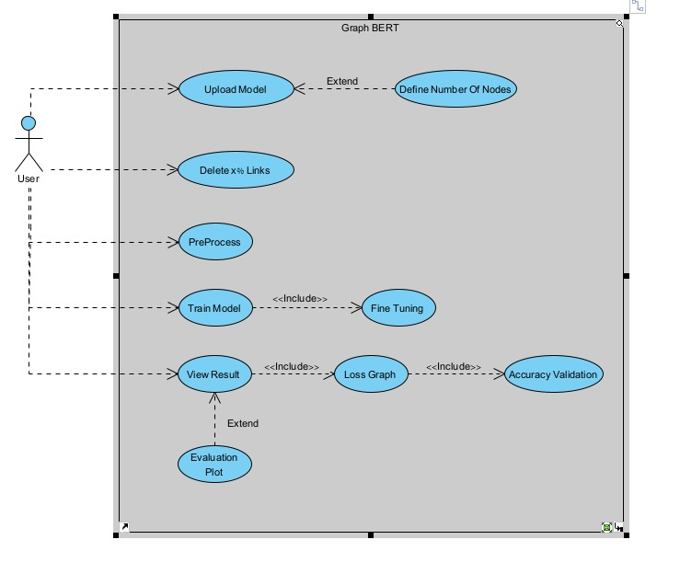
Use Case

Slide 16
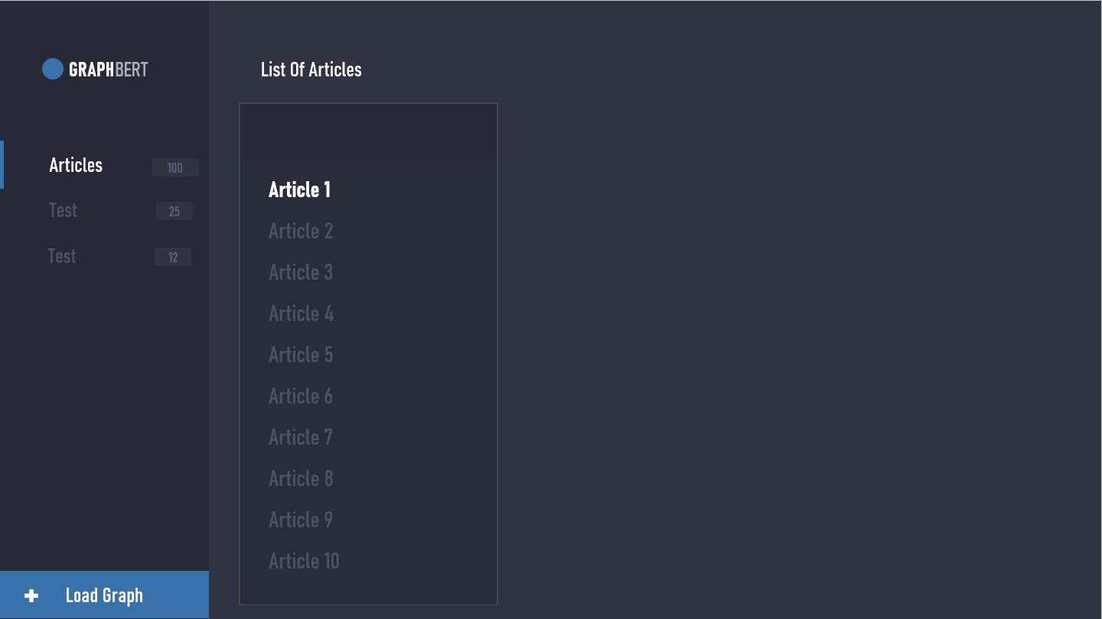
GUI

Slide 17
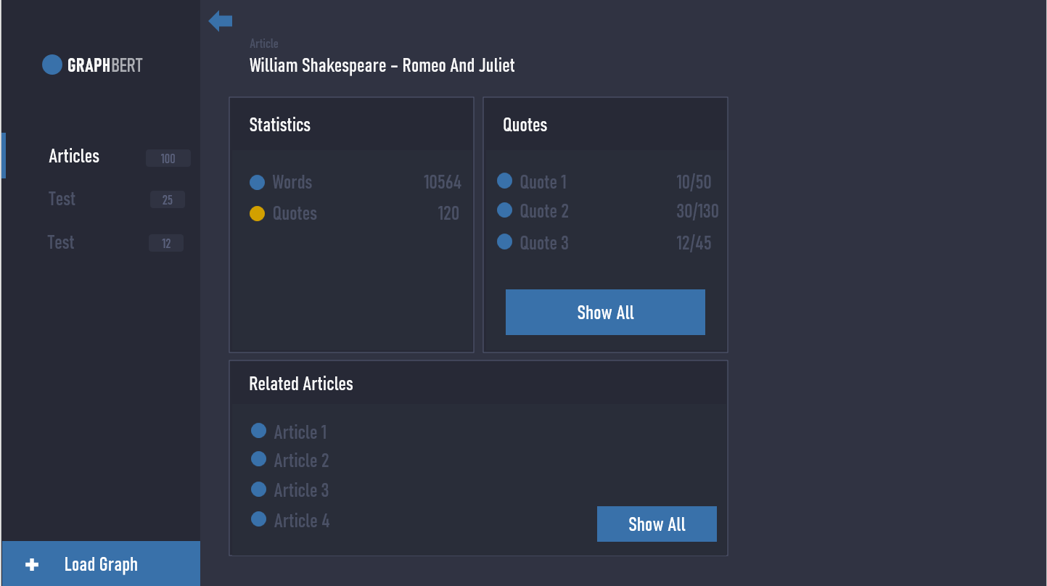
GUI

Slide 18
Verification Plan

Slide 19
Questions?

